Slide 1
Phase 2
Created a program to process arrays and strings using memory operations, control structures and arithmetic operations.
Group 5

Slide 2
Implementation Approach
Planned the design of functions using pseudocode.

Slide 3
Key Design Decisions
•Calling conventions

Slide 4
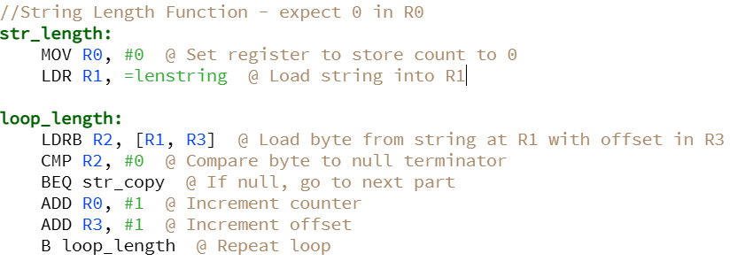
Test Results
https://cpulator.01xz.net/?sys=arm&loadasm=share/sSUbUC9.s

Slide 5
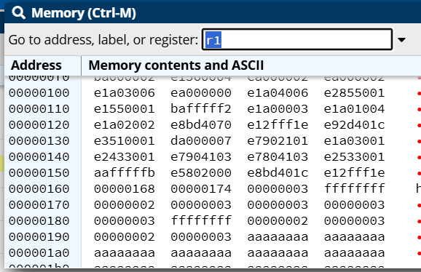
Live demonstration
Array Sort: CPUlator ARMv7 System Simulator

Slide 6
Lessons Learned
We could have used pseudocode for the entire program not just functions as we worked on those individually.

